Slide 1

Tic-Tac-Toe: Understanding the Minimax Algorithm
Adithya Vardhan.A-BL.EN.U4CSE21007
Ganugapati Sai Geethika -BL.EN.U4CSE21058
Maganti Akshita Uma Sai -BL.EN.U4CSE21118

Slide 2
Introduction
Overview of the evolution of games, transitioning from traditional to modern computer-based games.
Spotlight on zaminamina board game, a traditional Ghanaian game akin to Tic-Tac-Toe, played with noughts and crosses.
Unveiling the mathematical concepts behind Tic-Tac-Toe, with a specific emphasis on its potential for educational benefits, especially for children.
Outlining key conditions for combinatorial games, including two players, no chance devices, perfect information, and a conclusive end.
Brief mention of the Minimax Algorithm as a key focus for strategic analysis in understanding the Tic-Tac-Toe game.

Slide 3
Problem Statement
Unravel mathematical foundations of Tic-Tac-Toe, specifically Zaminamina draft.
Investigate symmetry, moves, and combinations across various game boards.
Implement Minimax algorithm for decision-making in game theory.
Enhance understanding of mathematics in the sport for broader applications.

Slide 4
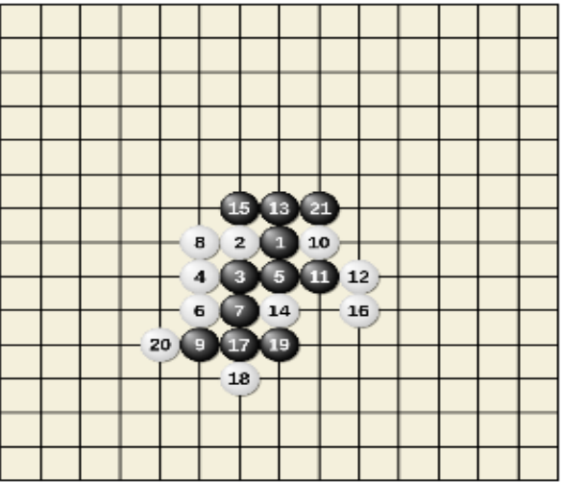
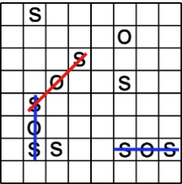
Gomoku
SOS 8x8 board game

Slide 5
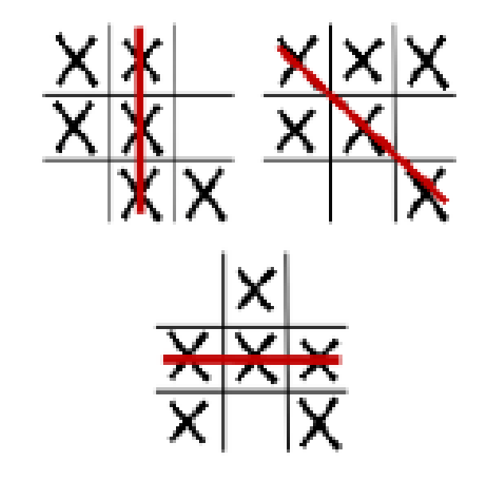
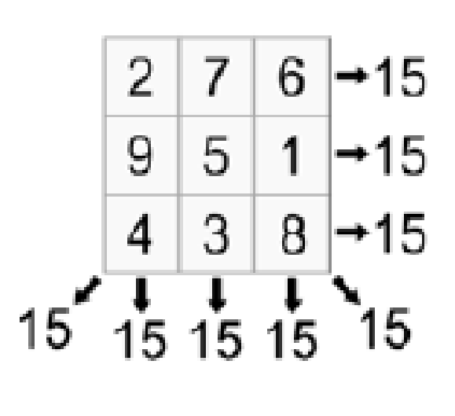
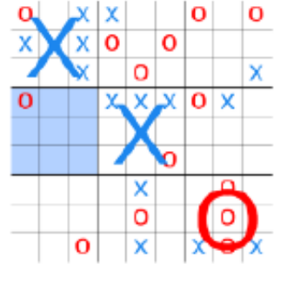
Notakto
Number Scrabble
Ultimate Tic-Tac-Toe

Slide 6
Algorithm Strategy
Tic-Tac-Toe Brute Force Flow:
Utilizes exhaustive computational power.
Explores all options without optimization.
Tic-Tac-Toe Alpha-Beta Flow:
Applies Alpha-Beta Minimax algorithm for efficiency.
Prunes decision tree branches not contributing to the goal state.
Optimizes space and time utilization for winning multiple games.

Slide 7
Implementation
Tic-Tac-Toe Game
Develop a representation of the Tic-Tac-Toe board.
Implement player moves and track the game state.
Incorporate game loop for continuous play until a win, loss, or draw.

Slide 8
Algorithmic Approaches:
Brute Force Flow:
Exhaustive exploration of all possible moves.
Alpha-Beta Minimax Flow:
Strategically prunes unnecessary decision tree branches.
Demonstrates efficient decision-making in Tic-Tac-Toe.
Simulation and Analysis:
Implements Brute Force and Alpha-Beta Minimax algorithms.
Analyzes various game scenarios for insights into algorithm effectiveness.

Slide 9
Code
board = ['-'] * 9
PLAYER_X = 'X'
PLAYER_O = 'O'
WINNING_COMBINATIONS = [
[0, 1, 2], [3, 4, 5], [6, 7, 8],
[0, 3, 6], [1, 4, 7], [2, 5, 8],
[0, 4, 8], [2, 4, 6]
]
def check_winner(player):
for combination in WINNING_COMBINATIONS:
if all(board[i] == player for i in combination):
return True
return False
def is_board_full():
return '-' not in board
def evaluate_board():
if check_winner(PLAYER_X):
return 1 # X wins
elif check_winner(PLAYER_O):
return -1 # O wins

Slide 10
else:
return 0 # Draw
def minimax(board, depth, is_maximizing):
if check_winner(PLAYER_X):
return 1
elif check_winner(PLAYER_O):
return -1
elif is_board_full():
return 0
if is_maximizing:
best_score = float('-inf')
for i in range(9):
if board[i] == '-':
board[i] = PLAYER_X
score = minimax(board, depth + 1, False)
board[i] = '-'
best_score = max(score, best_score)
return best_score
else:
best_score = float('inf')
for i in range(9):
if board[i] == '-':
board[i] = PLAYER_O
score = minimax(board, depth + 1, True)
board[i] = '-'
best_score = min(score, best_score)
return best_score

Slide 11
def find_best_move():
best_score = float('-inf')
best_move = -1
for i in range(9):
if board[i] == '-':
board[i] = PLAYER_X
score = minimax(board, 0, False)
board[i] = '-'
if score > best_score:
best_score = score
best_move = i
return best_move
def play_game():
while True:
print_board()
if check_winner(PLAYER_X):
print("You lose!")
break
elif check_winner(PLAYER_O):
print("You win!")
break
elif is_board_full():
print("It's a draw!")
break

Slide 12
move = int(input("Enter your move (0-8): "))
if move < 0 or move > 8 or board[move] != '-':
print("Invalid move. Try again.")
continue
board[move] = PLAYER_O
if is_board_full():
print("It's a draw!")
break
print("AI is thinking...")
ai_move = find_best_move()
board[ai_move] = PLAYER_X
def print_board():
for i in range(0, 9, 3):
print(board[i], board[i + 1], board[i + 2])
# Start the game
play_game()

Slide 13
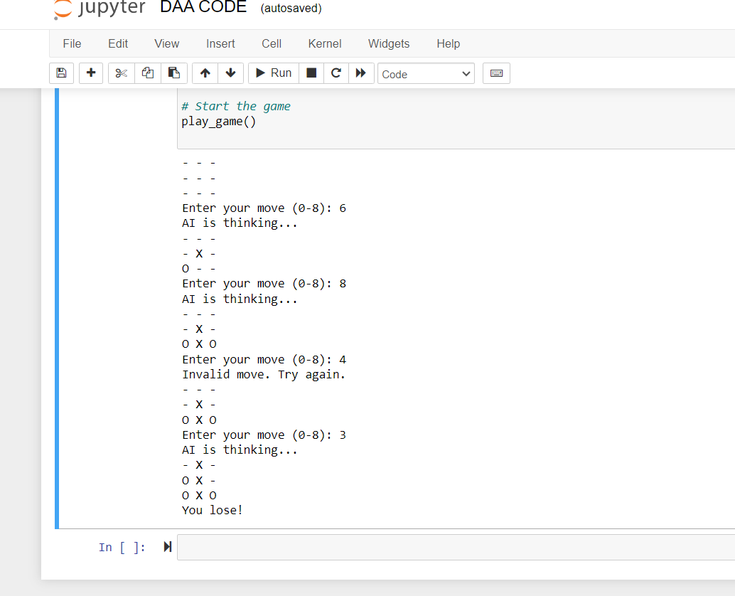

Slide 14
Conclusion & Future Scope:
Conclusion:
Summarizes contributions and intelligent mathematical techniques.
Highlights winning strategy through Alpha-Beta Minimax flow.
Emphasizes mathematical analysis in strategic play for broader applications.
Future Scope:
Suggests extension to more complex games like chess.
Explores avenues for enhancing efficiency and adaptability of Tic-Tac-Toe algorithm.
Encourages further research in game theory, mathematics, and computational efficiency.
Lays foundation for advancing strategies in various combinatorial games.

